Slide 1
SALESFORCE TRAINING

Slide 2
PMC / Property / Orders Review
Review these sections in Salesforce as part of your pre-kick off research

Slide 3
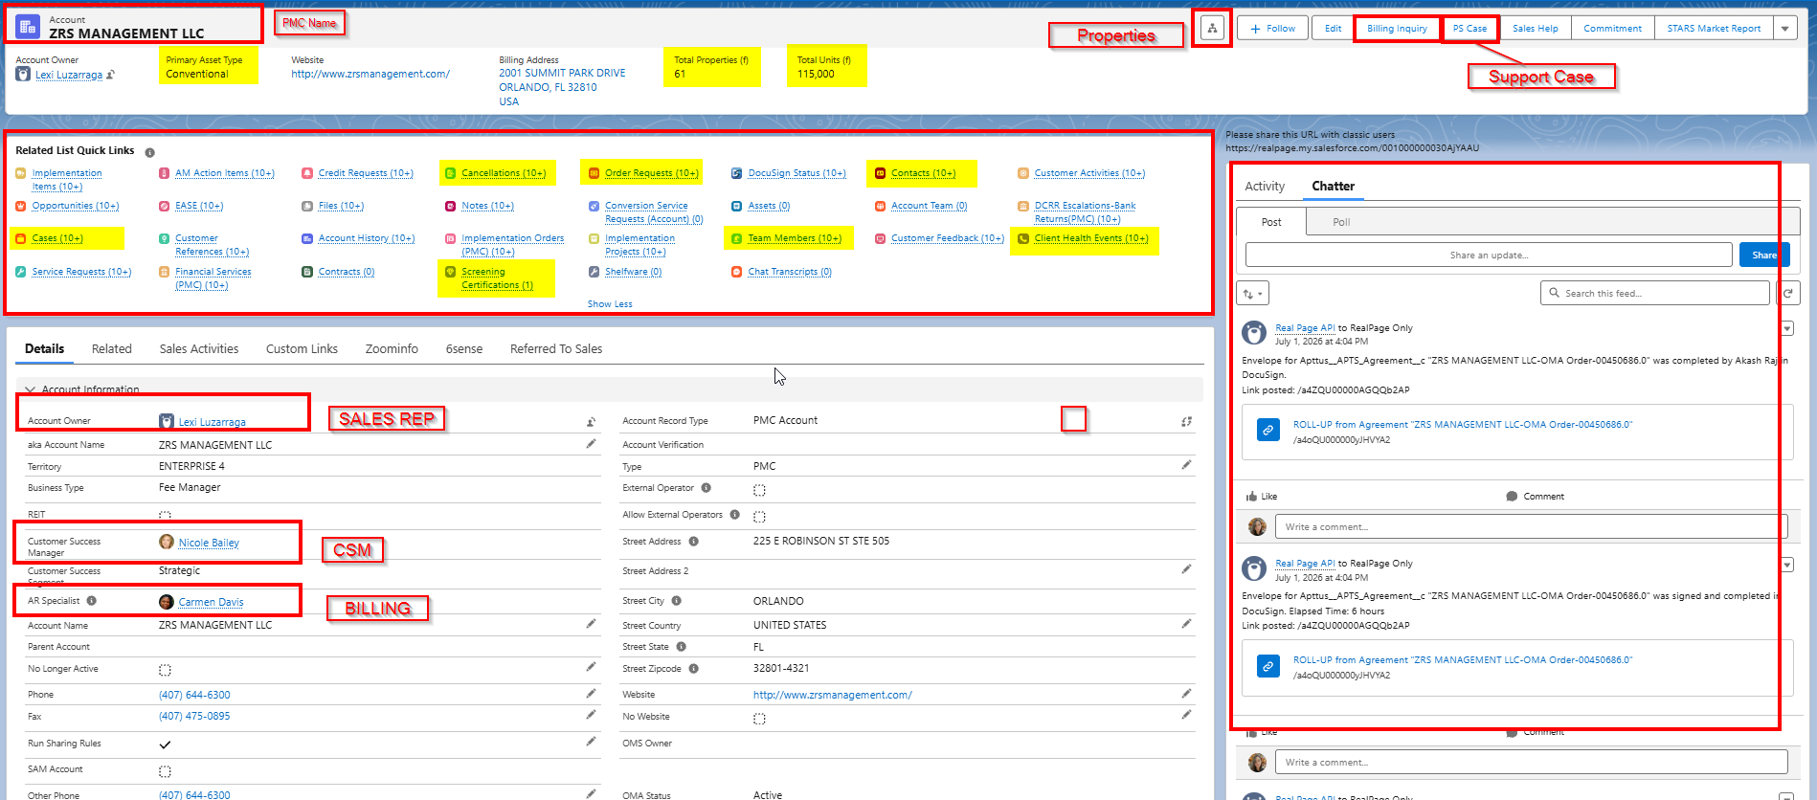
PMC PAGE

Slide 4
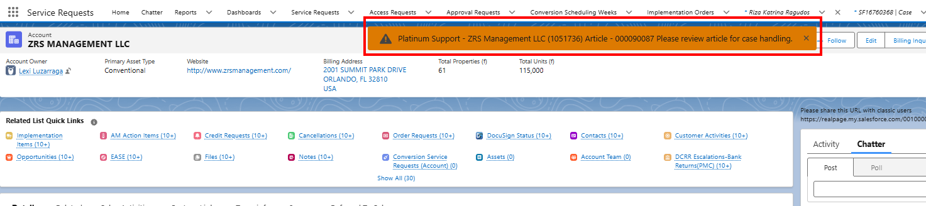
PMC PAGE (cont.)

Slide 5
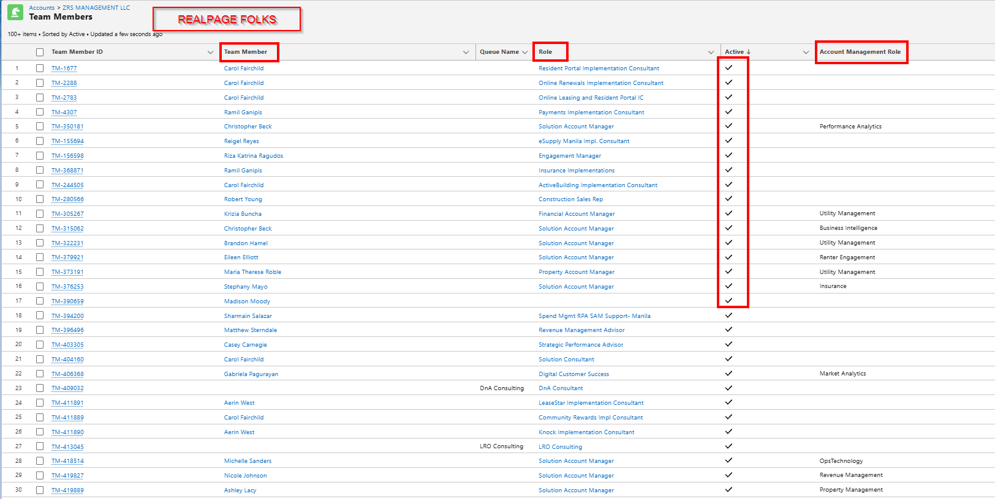
TEAM MEMBERS (RealPage)
RP Members assigned to this PMC
Look for (✓) under Active = engaged

Slide 6
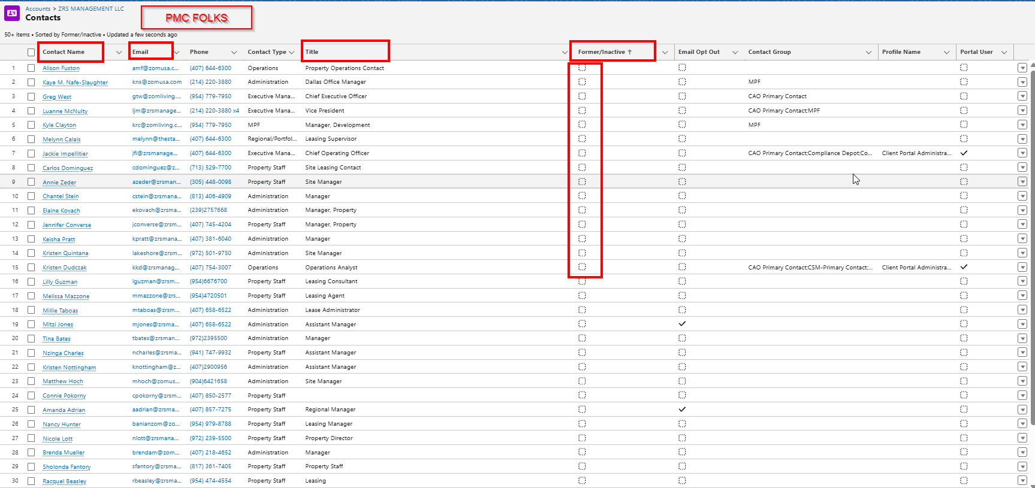
Contacts(PMC)

Slide 7
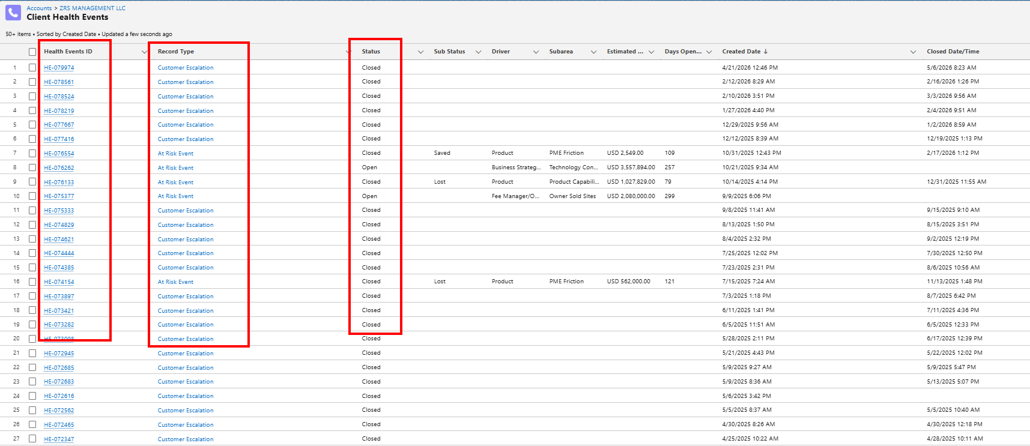
Good to Know: Client Health Events (CHEs)
Escalations Raised by clients
Risks flagged by Sales or Customer Success

Slide 8
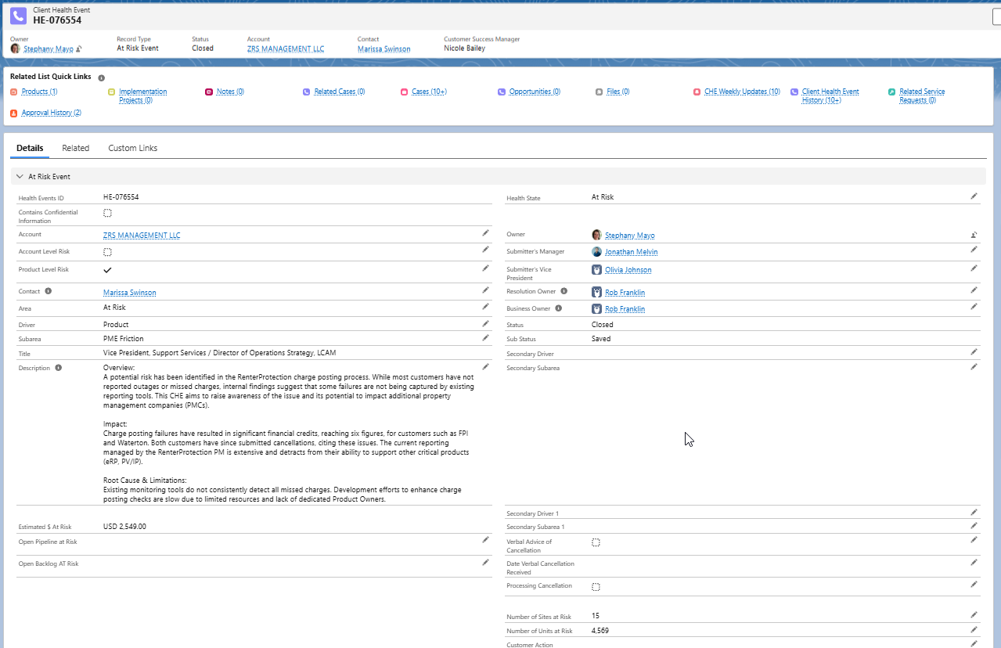
Client Health Events (CHEs)
Reviewing recent CHE can help understand client sentiments
Focus on any implementation related risks/escalations

Slide 9
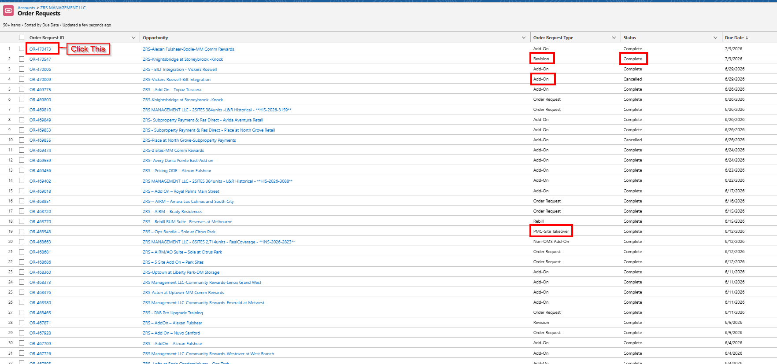
Important: Order Requests (PMC)
All Orders Raised by the PMC
Check for Order Notes or upcoming acquisitions (long term)
Take note of Revisions/Rebill

Slide 10
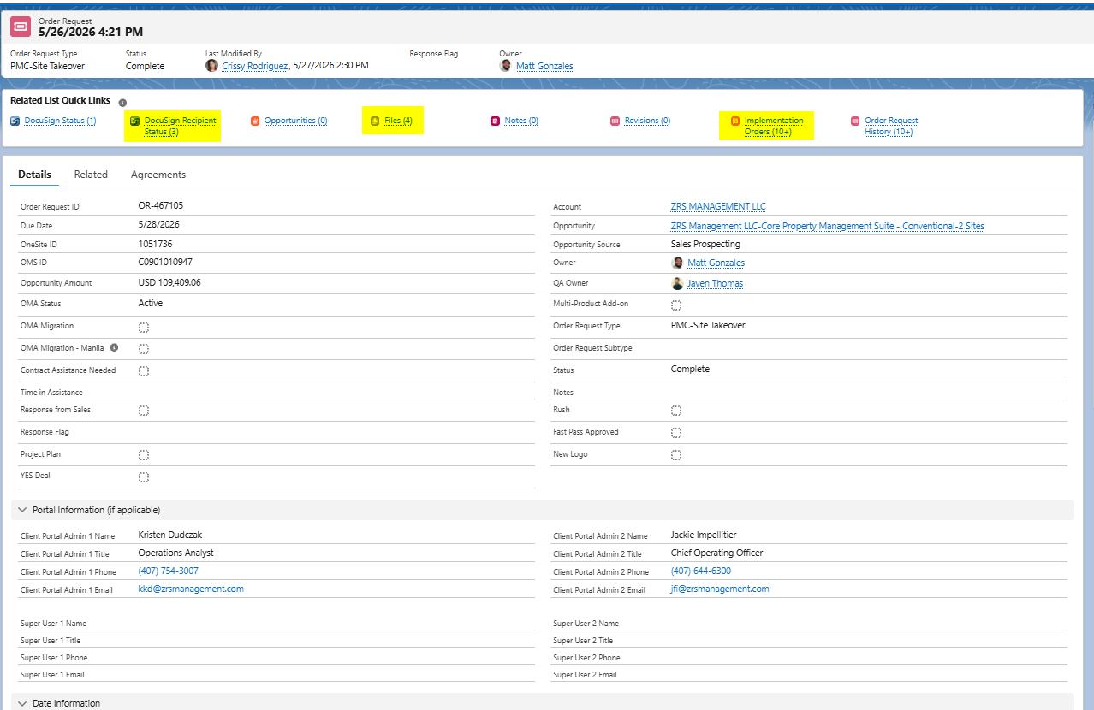
Order Requests (PMC)
Docusign Recipient Status – track order signature (Sales > Client)
Files – order form drafts
Implementation Orders – list down all solutions included in that order

Slide 11
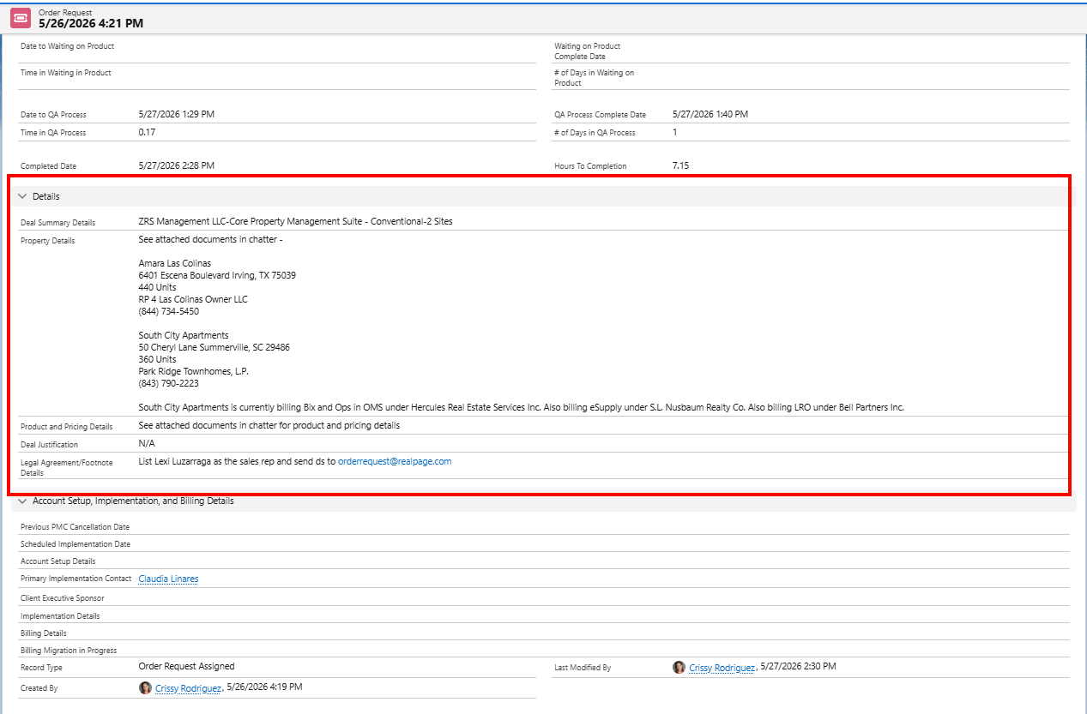
Order Requests (PMC)
Order Details – sometimes includes property information which can be useful when you are doing your pre-kick off research
Especially helpful for OneSite takeovers

Slide 12
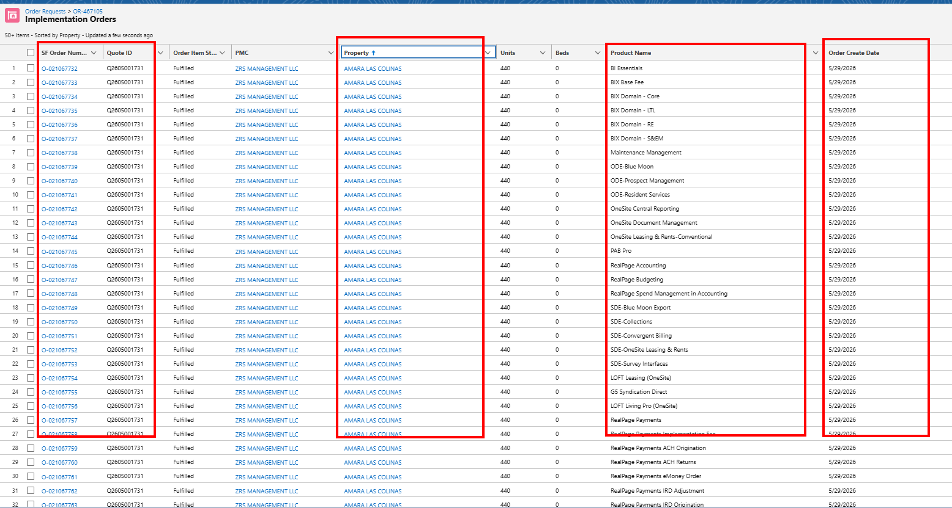
Implementation Orders (per Order Request)

Slide 13
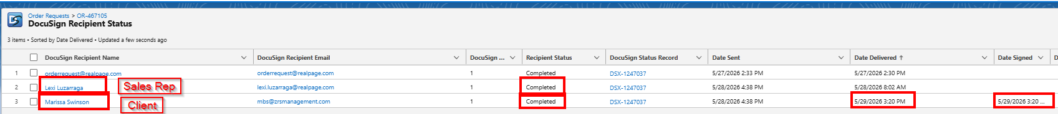
Docusign Recipient Status

Slide 14
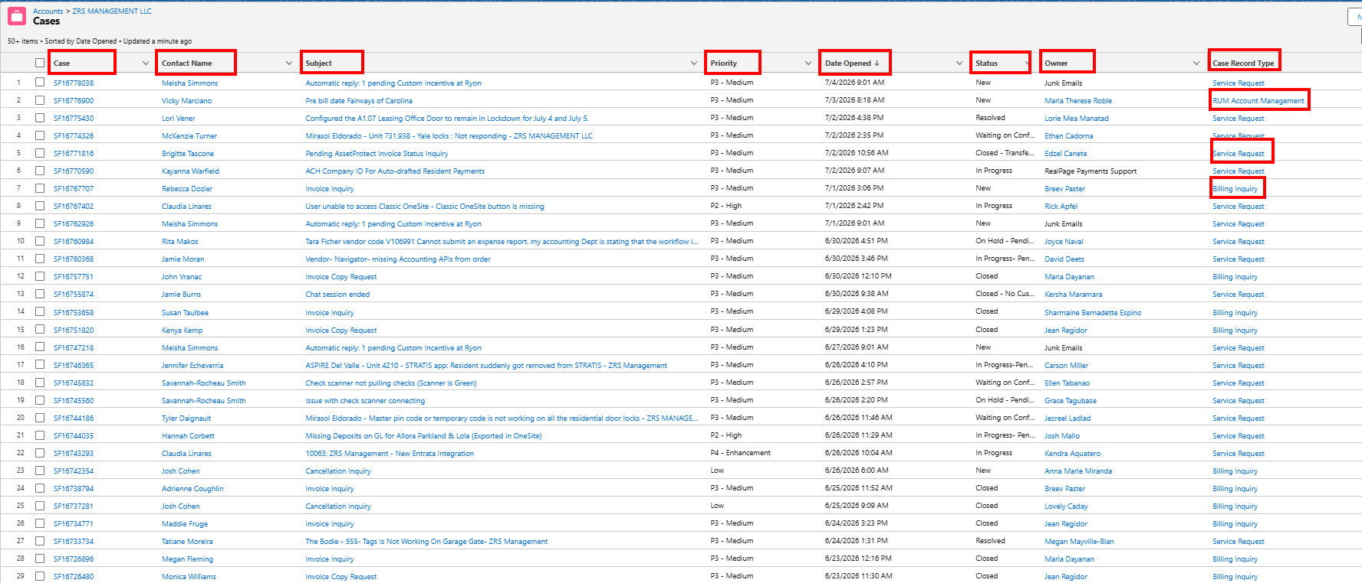
Additional Info: CASES (PMC)
Support cases raised at the PMC level
Also includes Billing/Cancellation Inquiries

Slide 15
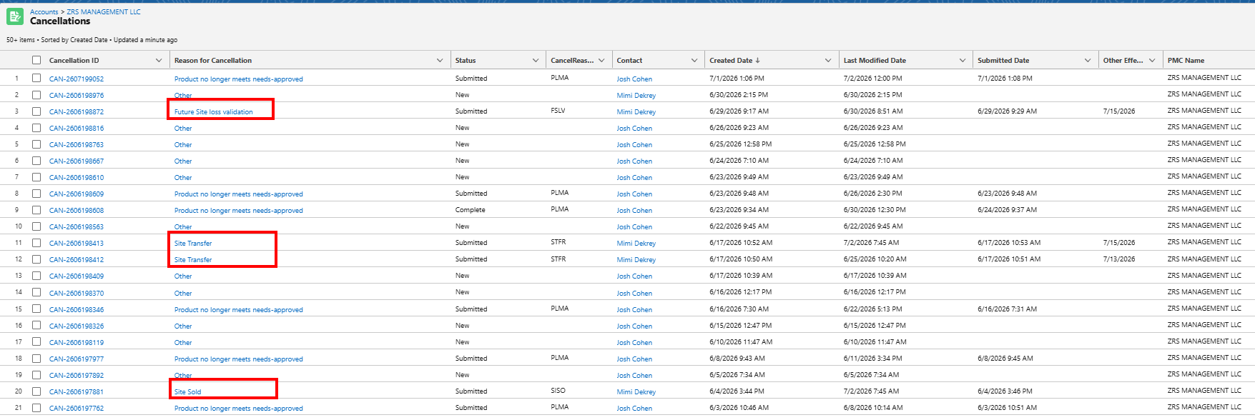
Additional Info: CANCELLATIONS (PMC)
Cancellations placed by the clients (drafts, completed)
Can be per site or per product

Slide 16
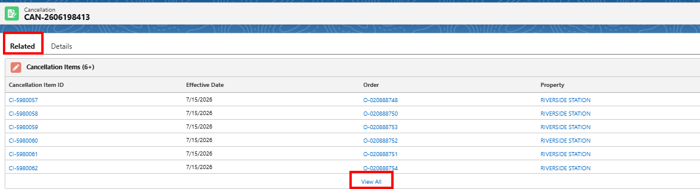
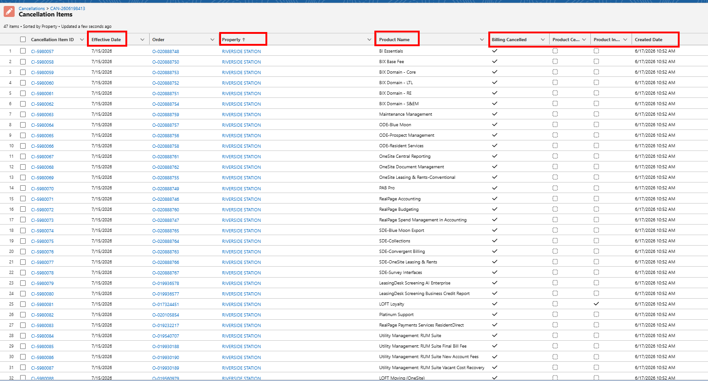
CANCELLATIONS (PMC)
Review Cancellation details by clicking Cancellation ID
Useful for OneSite Takeovers

Slide 17
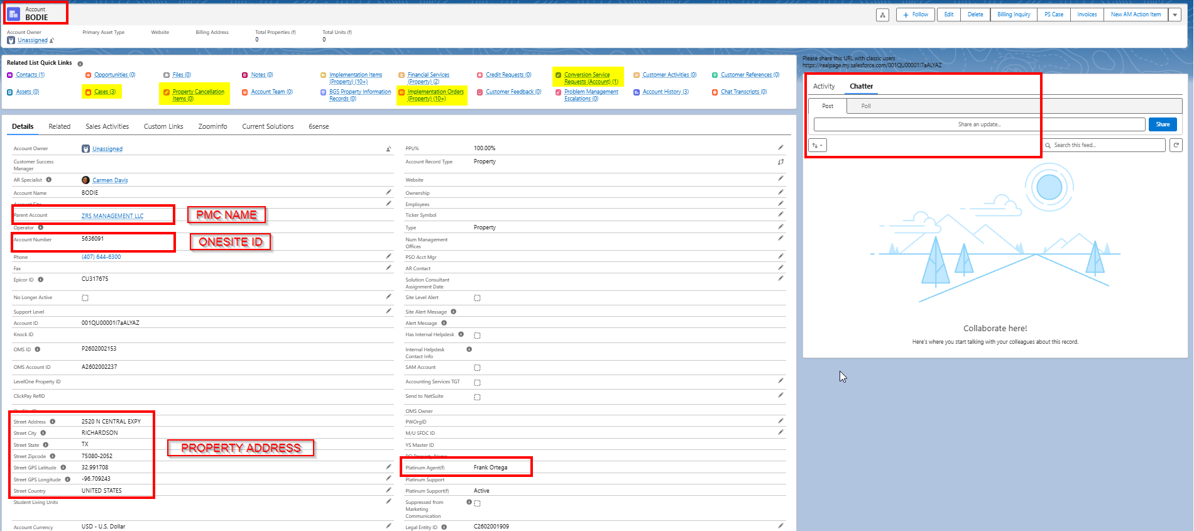
Property Page

Slide 18
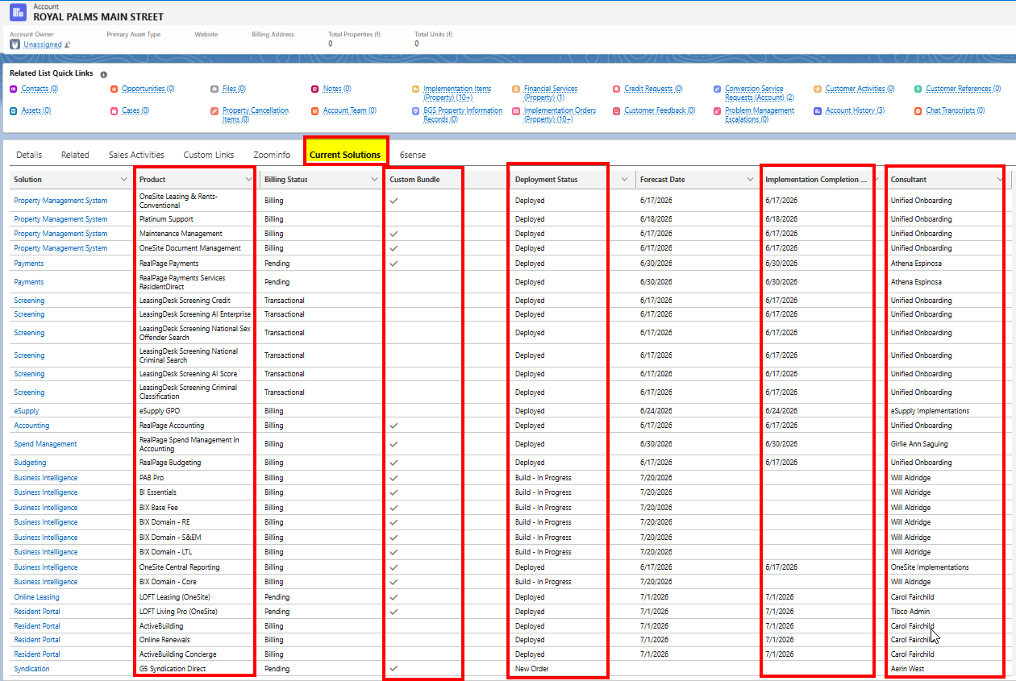
PROPERTY PAGE (Current Solutions)
Quick glance on solutions ordered
Tells you the property Flavor
Quickly identify product bundles

Slide 19
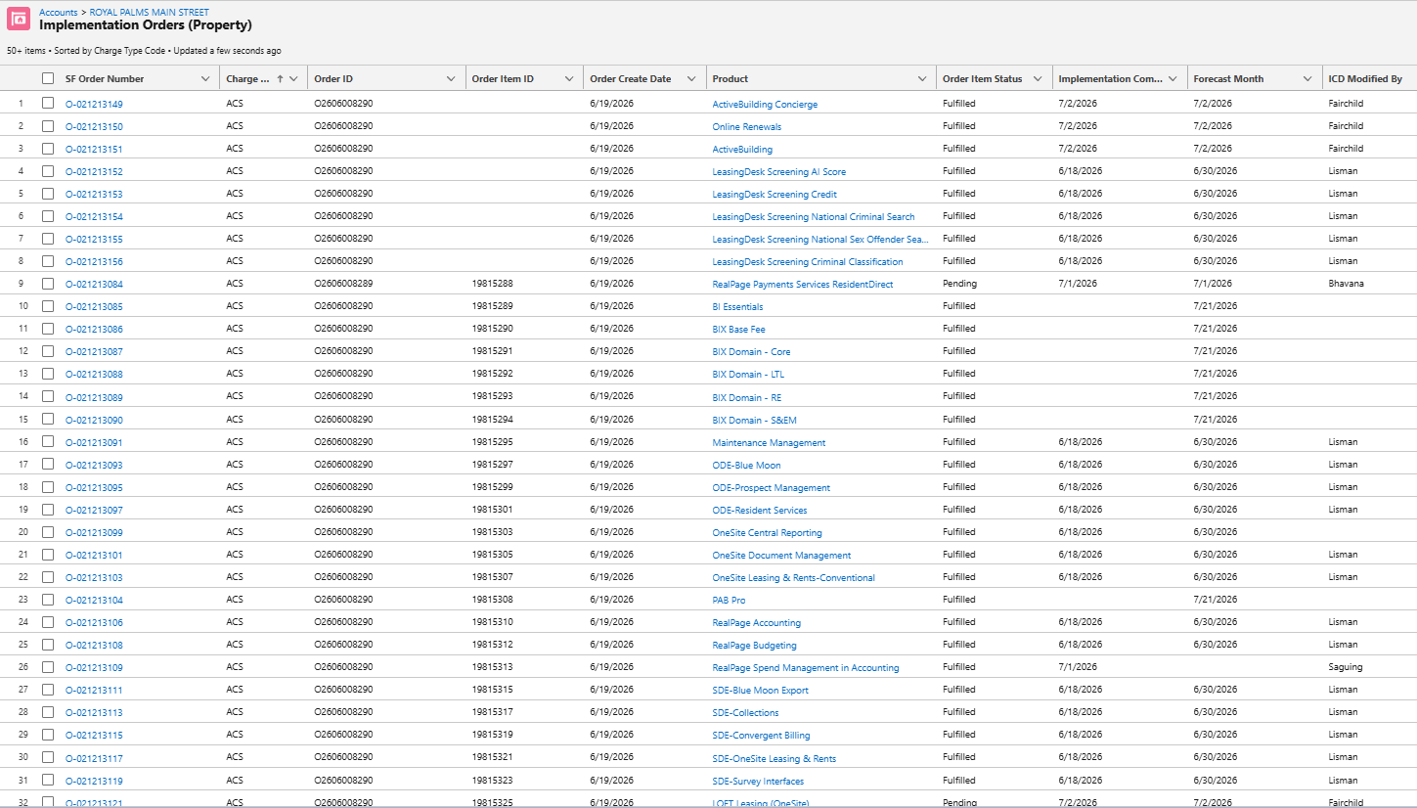
Implementation Orders (Property)
All solutions ordered for that property
More updated than signed order forms (due to revisions or additional orders)
ACS vs ILF

Slide 20
Implementation Order Details
Good to review before and during implementations

Slide 21
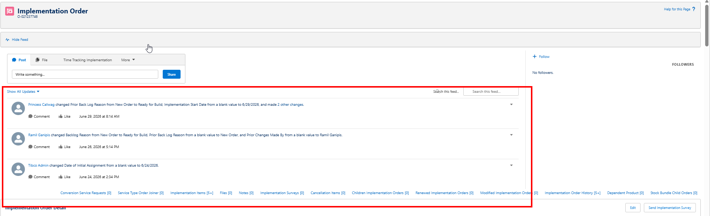
Implementation Orders (Details)
Click on SF Order Number to access Implementation Order Details

Slide 22
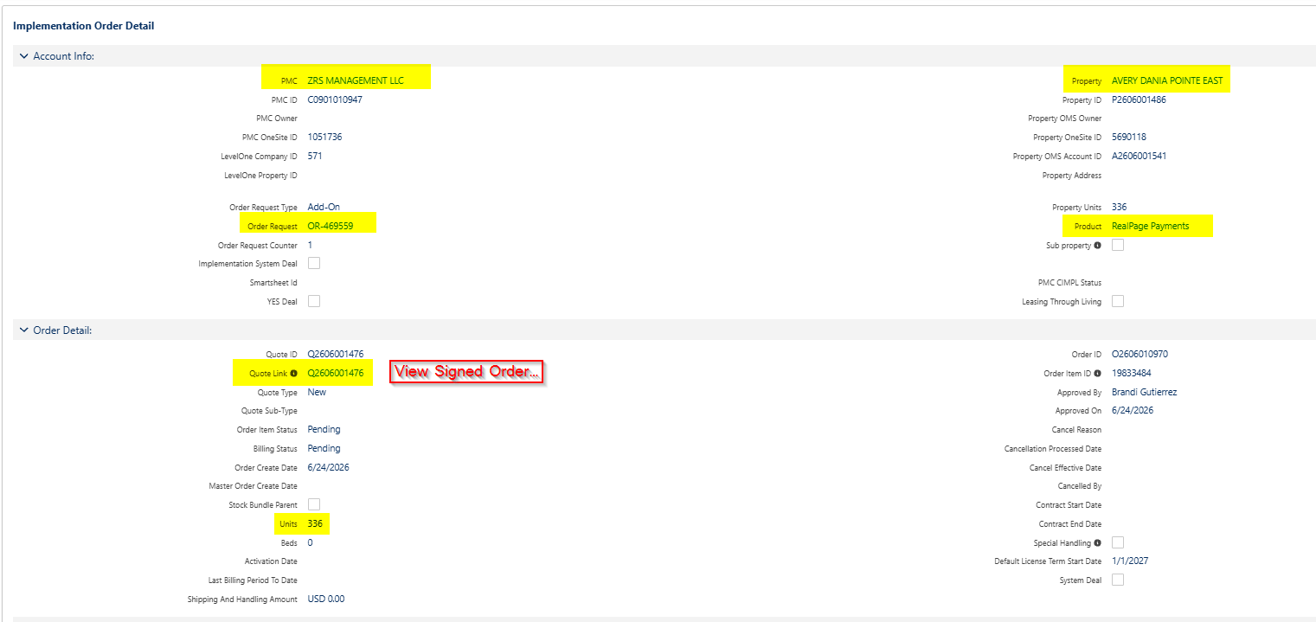
Implementation Orders (Details)
Click on SF Order Number to access Implementation Order Details

Slide 23
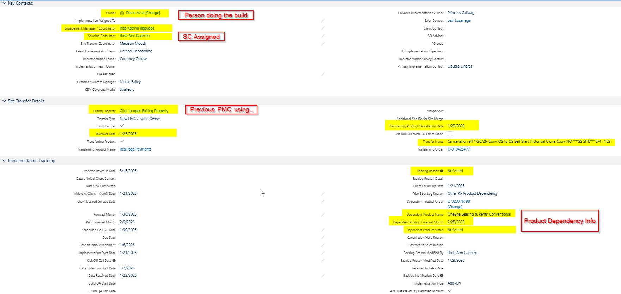
Implementation Orders (Details)
Click on SF Order Number to access Implementation Order Details

Slide 24
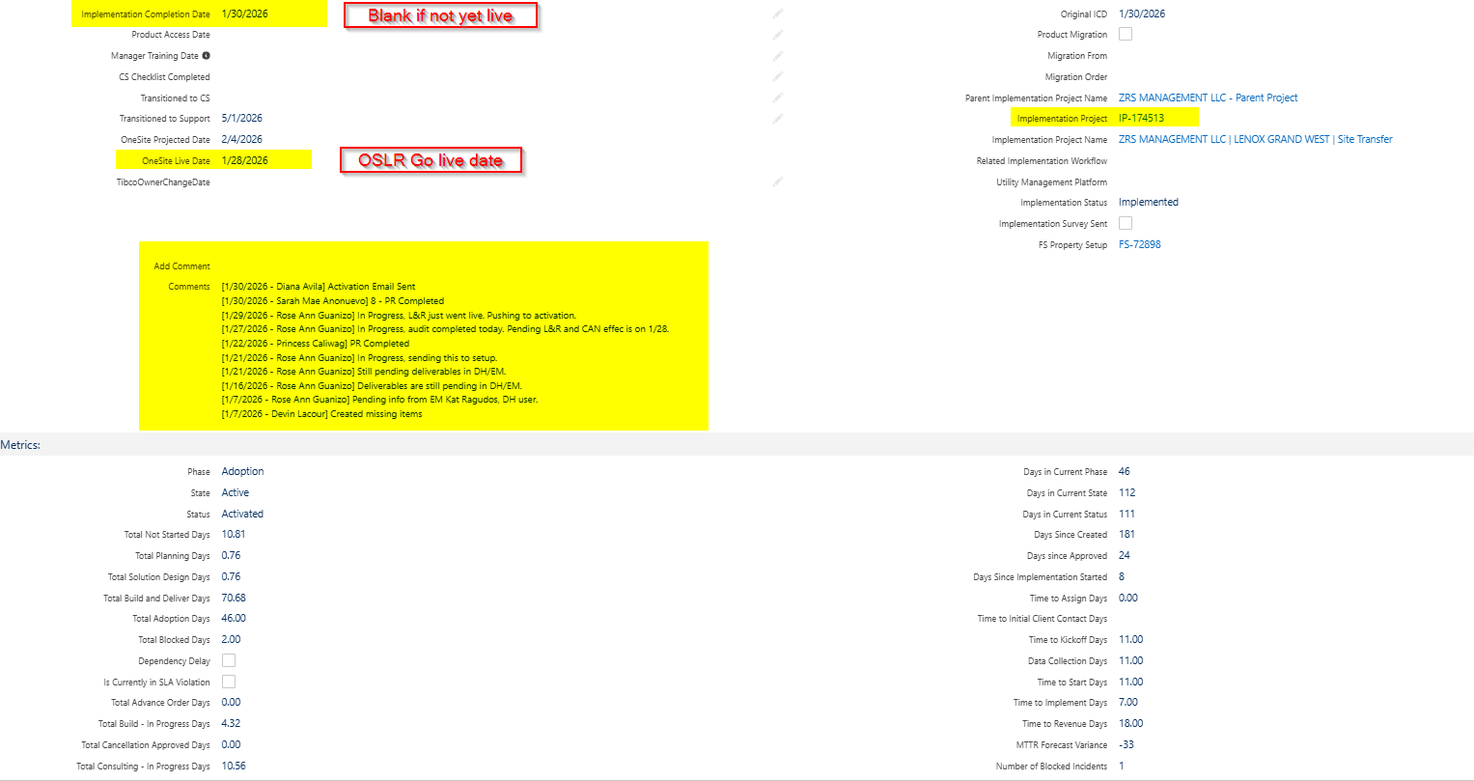
Implementation Orders (Details)
Click on SF Order Number to access Implementation Order Details

Slide 25
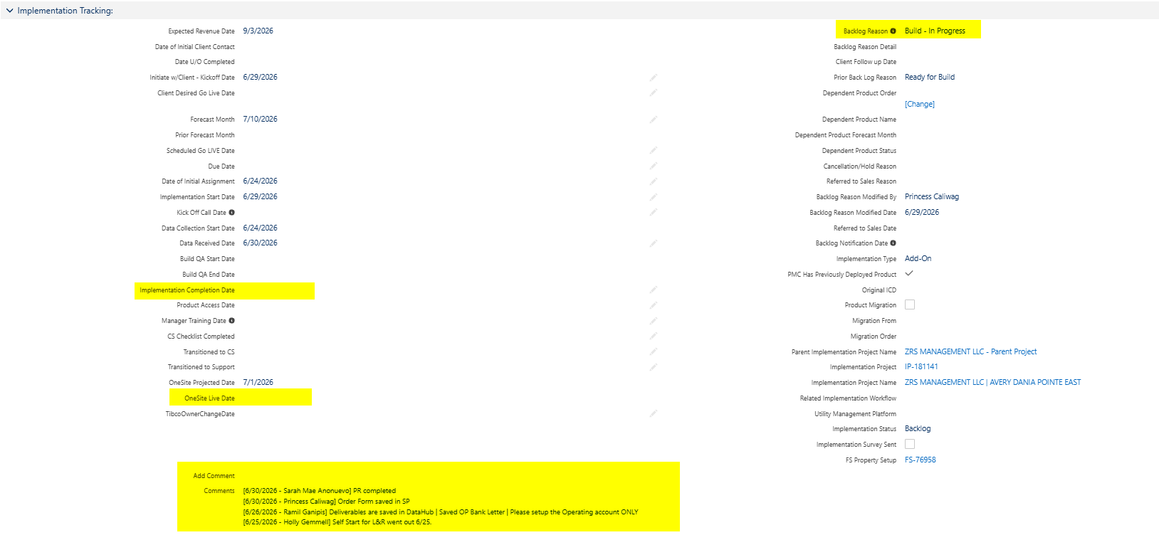
Implementation Orders (Details)
Click on SF Order Number to access Implementation Order Details

Slide 26
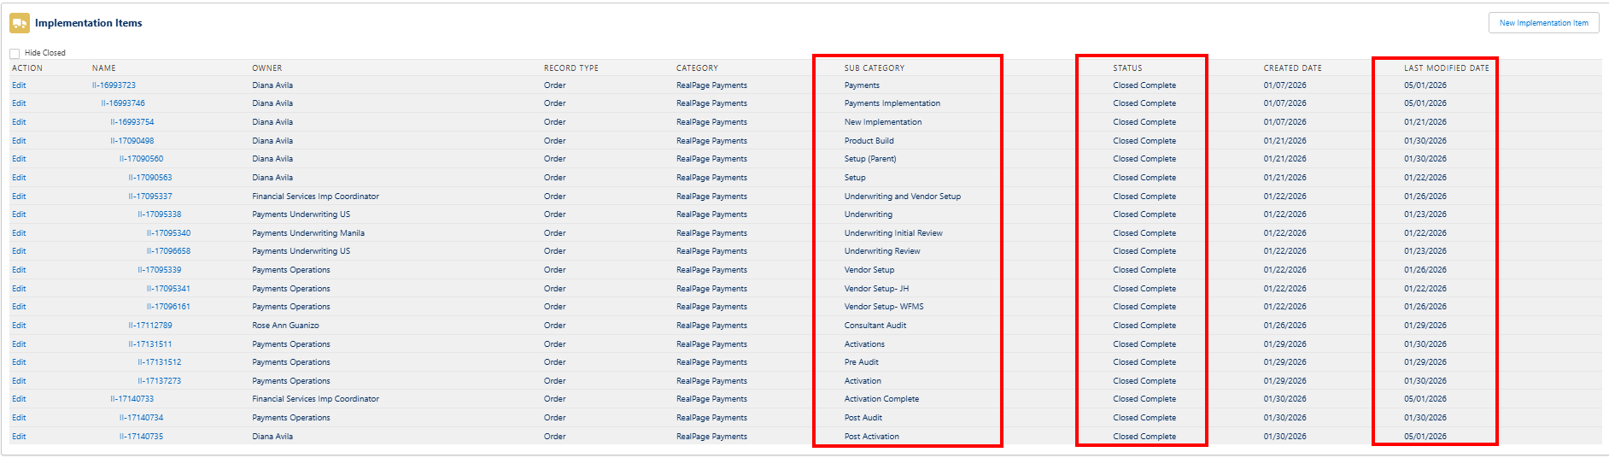
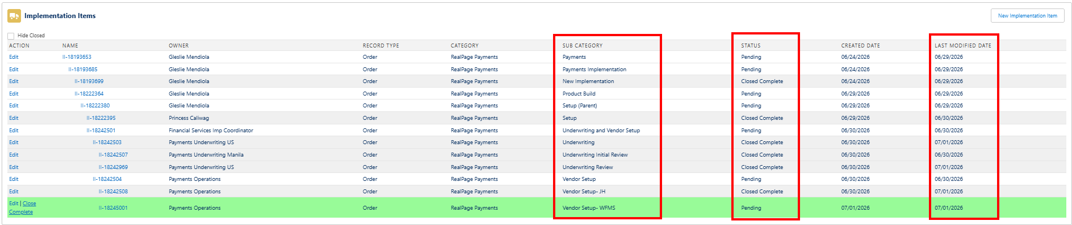
Implementation Orders (Details)
Click on SF Order Number to access Implementation Order Details

